Slide 1
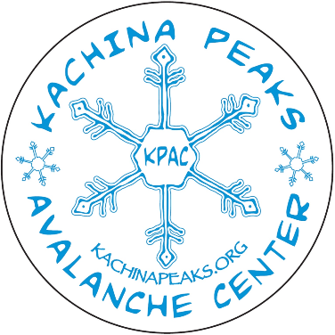
Introduction to Avalanches
How to recognize and understand conditions that should be avoided in the winter environment

Slide 2
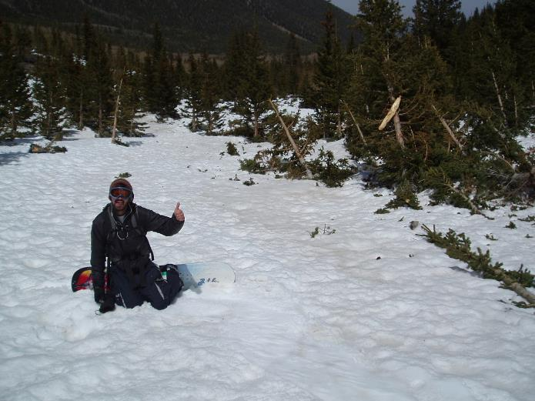
In Memory of Josh Tourjee who loved snow, teaching about avalanches and San Francisco Peaks

Slide 3
So why is this important to us?
We live in the desert – Avalanches don’t occur here
Only 1 in 10 victims are rescued alive from a complete burial
Winter recreation in avalanche terrain is blossoming - avalanches are the number one killer on Forest Service Lands
Ease of access, the Snowbowl and open boundaries
2000-2009 an average of 28 people have died a year in the US – 42 in N. America
We have been fortunate so far – let’s keep it that way

Slide 4
The Essentials (+3)
Fire starter (weather-poof aids)
Extra food
Extra water
First Aid Kit
Extra warm clothing (synthetic or down)
Navigation equipment (map, compass, GPS)
Pocket knife/multi-tool and repair kit
Headlamp and extra batteries
Storm gear or improvised shelter
Sun protection (sunglasses, goggles, sunscreen)
A word about cell phones

Slide 5
Plus Three
Rescue Shovel
Probe or probe ski poles
Avalanche Transceiver

Slide 6
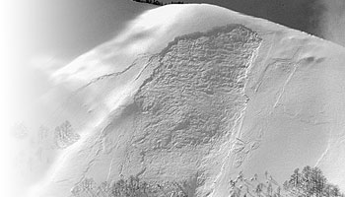
So, what is an avalanche?
Avalanche: A mass of snow sliding, tumbling, or flowing down an inclined surface in response to gravity.

Slide 7
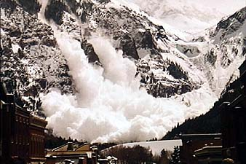
There are a variety of avalanche types…
Loose Snow
Avalanches
Glacial Ice
Avalanches
Slab Avalanches

Slide 8
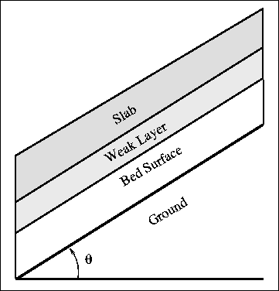
Parts of a slab avalanche
Slab- relatively harder more cohesive snow that slides
Weak layer- low density poorly bonded snow, that fractures and causes the slab to slide
Bed surface- harder, smooth surface than the slab can slide on (can be the ground)
Strong layers are avalanches, weak layers cause avalanches.

Slide 9
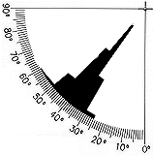
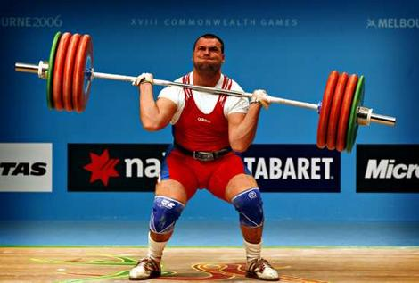
Four Ingredients for a Slab Avalanche!
1. Slope 2. Weak
layer
3. Loaded slab

Slide 10
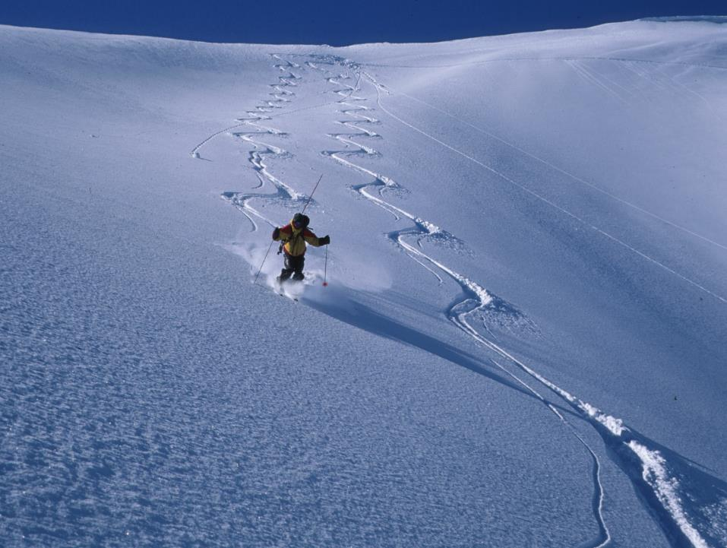
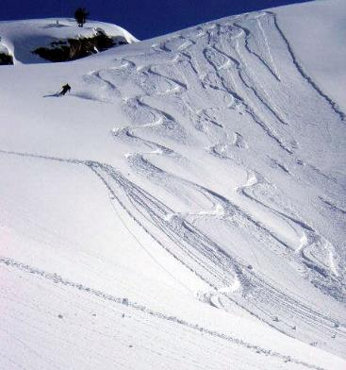
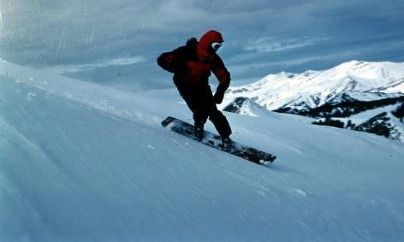
4. A trigger

Slide 11
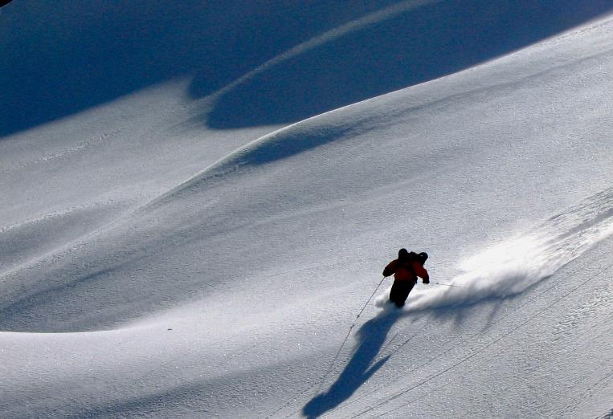
Without winter recreationists there would be few avalanche fatalities

Slide 12
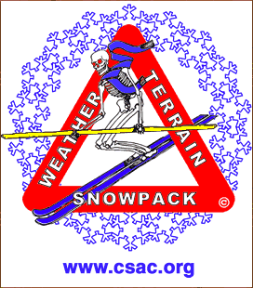
The Avalanche Triangle

Slide 13
Terrain
Obvious Avalanche Paths (open slopes, debris, flagged and dwarfed trees)
Slope Angle (30 – 45 degrees)
Aspect (direction slope faces)
Lee as opposed to windward
Convexities (rollovers)
Terrain Traps (confinements, crevasses/ravines, cliffs, flat run-outs, lakes or streams)

Slide 14
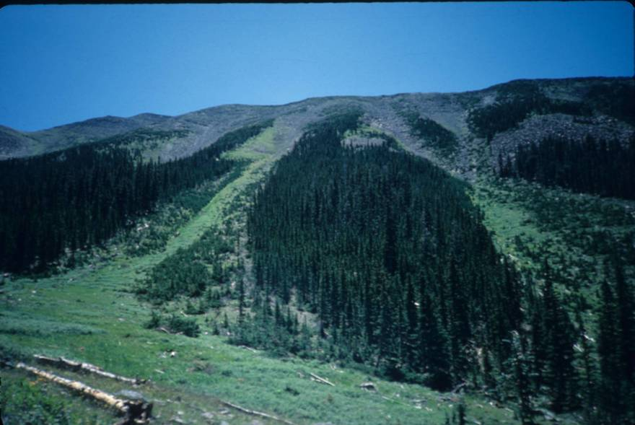

Slide 15
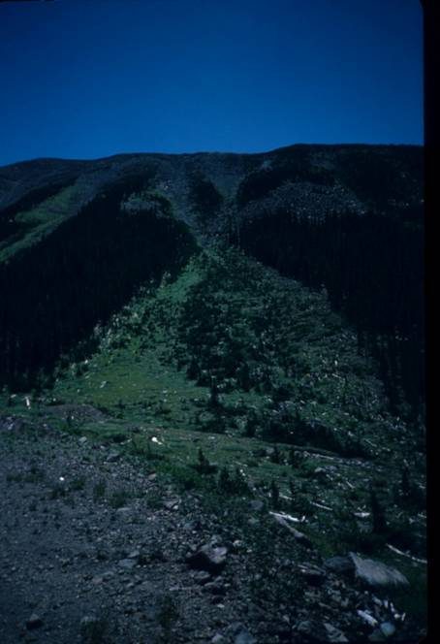

Slide 16
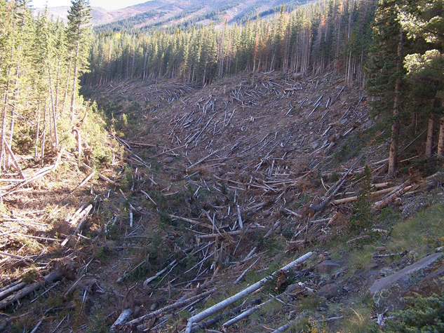

Slide 17
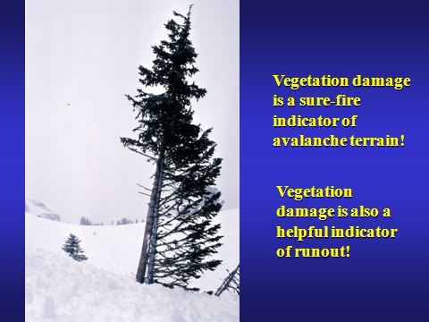

Slide 18
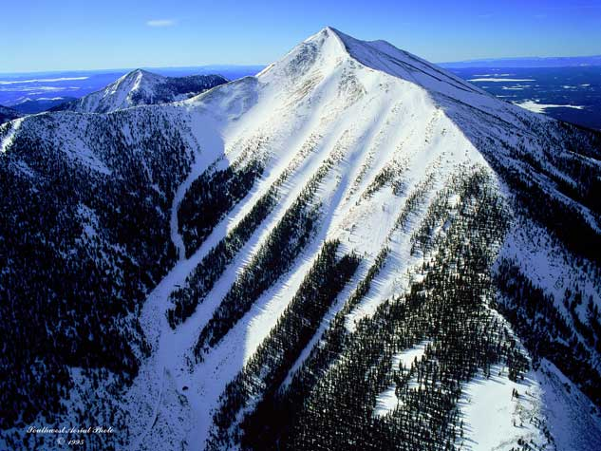

Slide 19
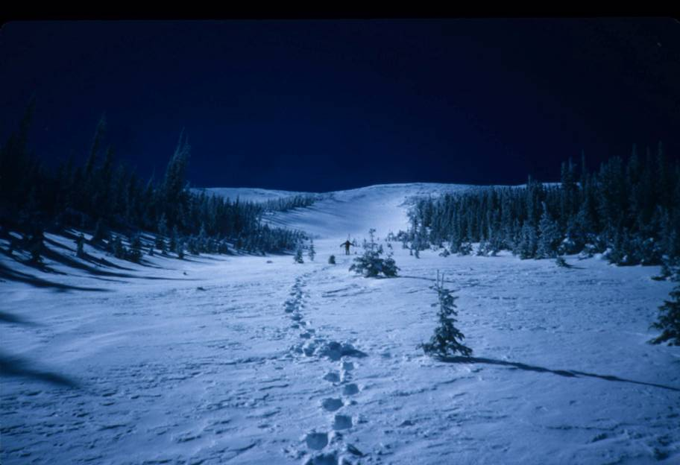

Slide 20
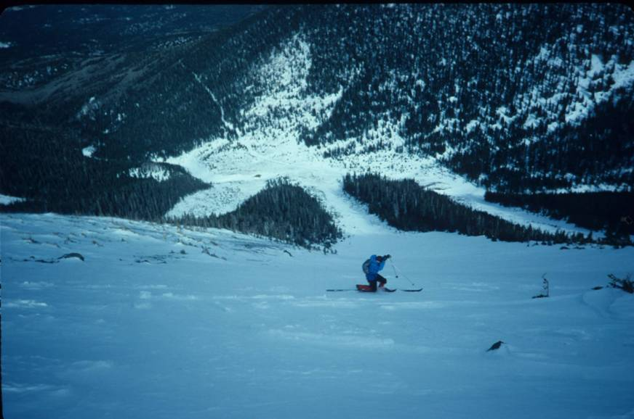

Slide 21
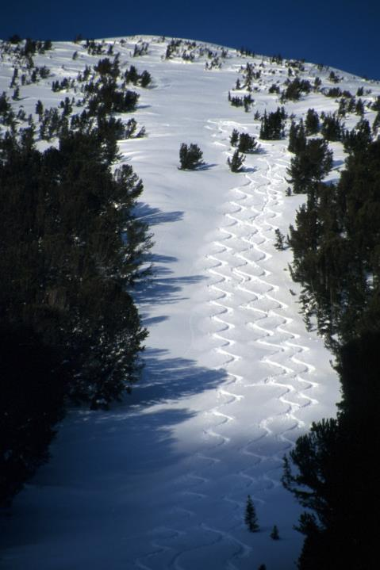

Slide 22
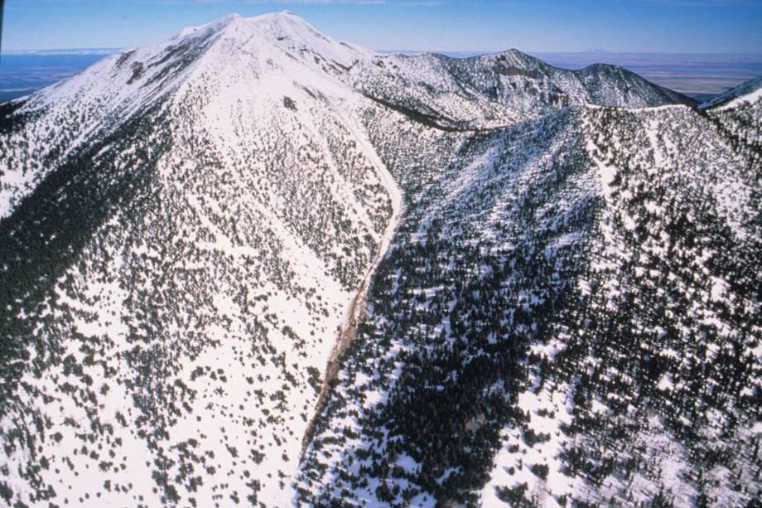

Slide 23
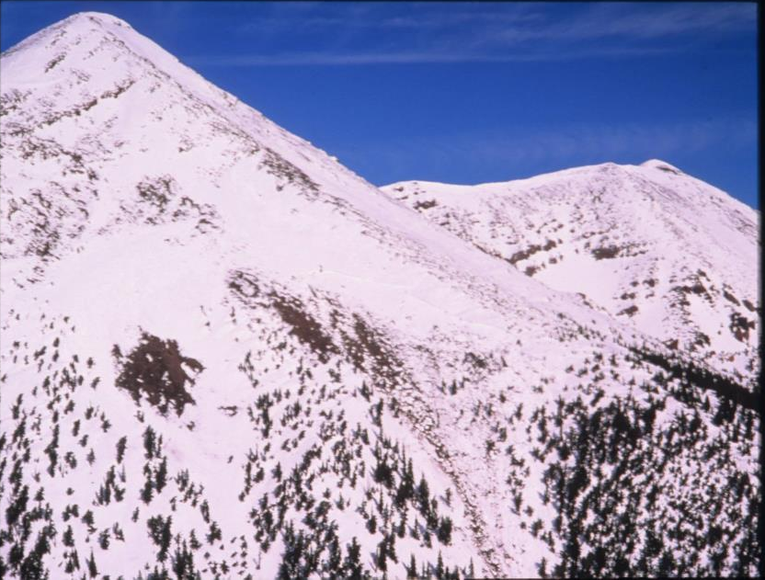

Slide 24
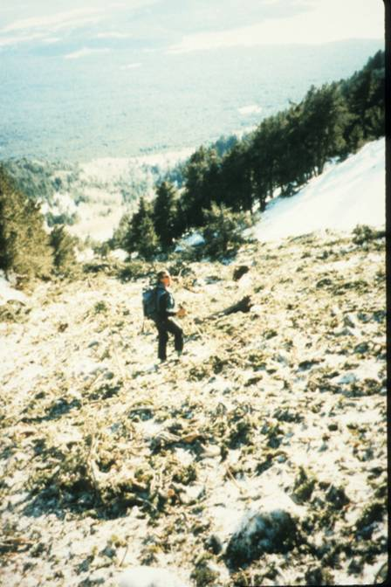

Slide 25
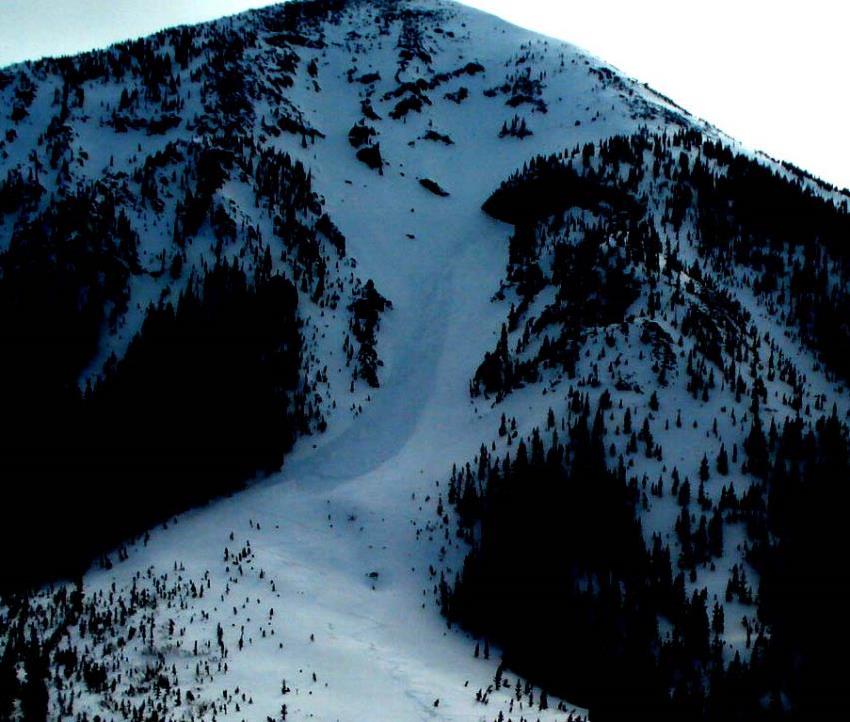

Slide 26
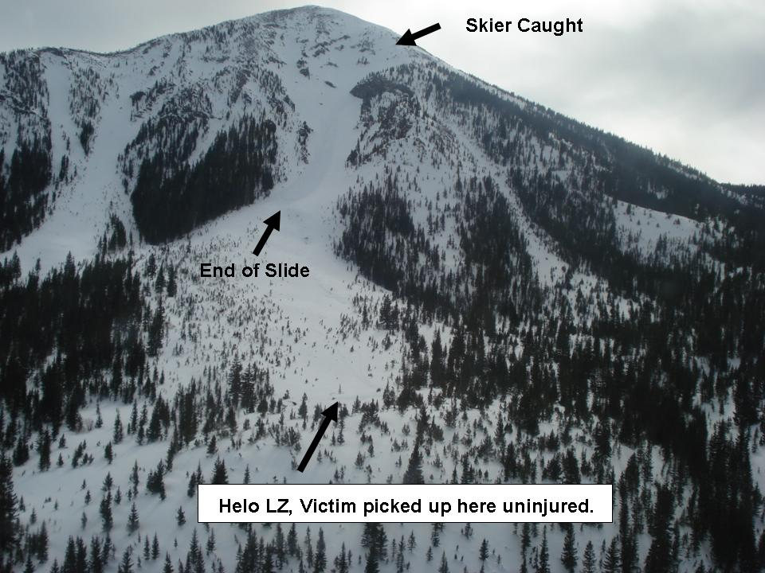

Slide 27
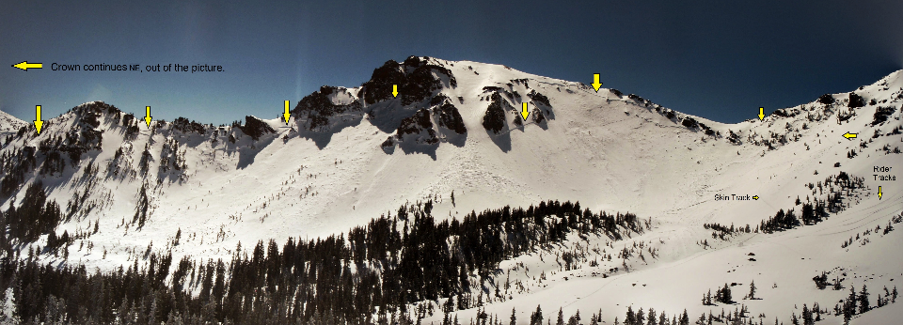
Early March 2015 Avalanche Cycle in the Inner Basin

Slide 28
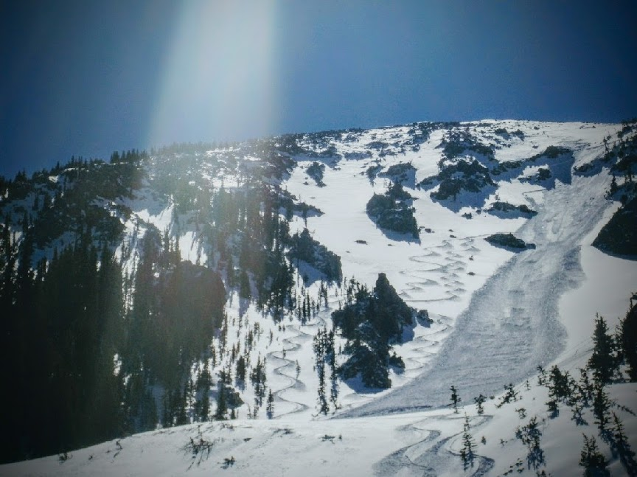
Skier triggered soft slab, February 2011
Photo by Ken Lane

Slide 29
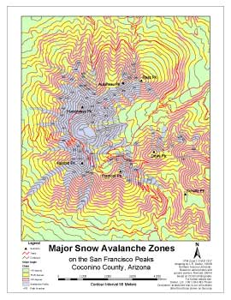
Learn your way around the Peaks
Aspects
Avalanche Paths
Gullies
Escape Routes

Slide 30
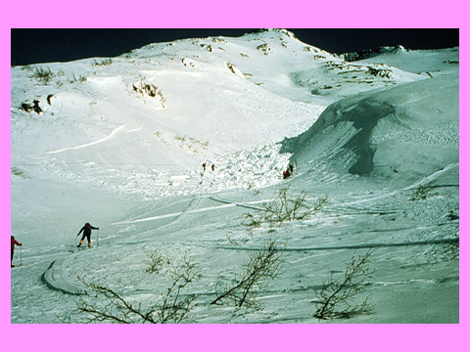
Terrain Traps

Slide 31
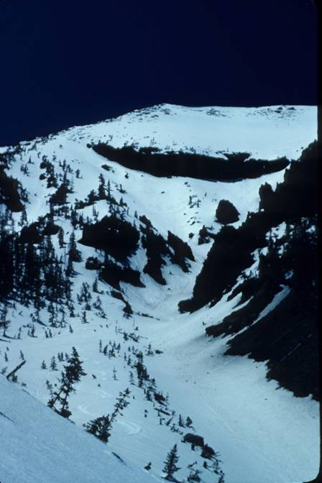

Slide 32
Weather
Seasonal weather history
Precipitation - Snowfall (rate, SWE,
or rain on snow)
Wind (velocity, duration, and available snow for transport)
Temperature (cold spells and thaw instability)

Slide 33
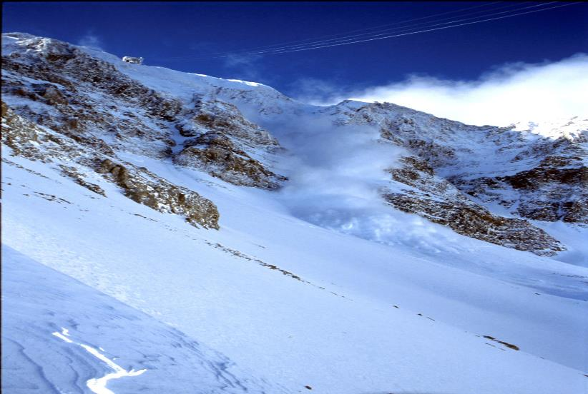
Has loading occurred recently?
(snow or rain > 1inch SWE, 12”snow in 24 hours, 8” in 12 hours)
Give snow a chance to settle and bond
after big storms
Notes:
33

Slide 34
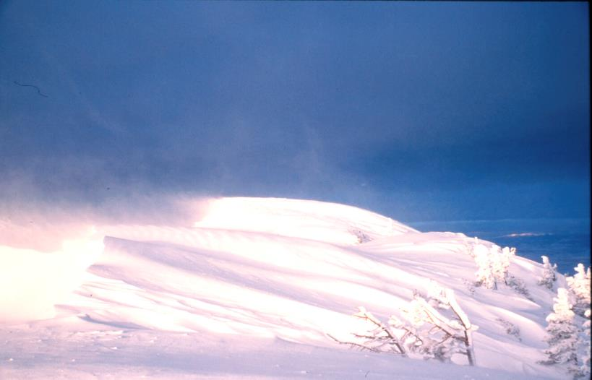
Remember, wind = snow storm
If snow is available to move, it is deposited by wind many times faster than it falls from the sky
Notes:
34

Slide 35
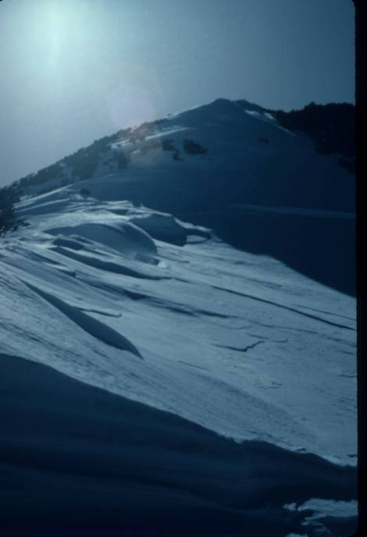

Slide 36
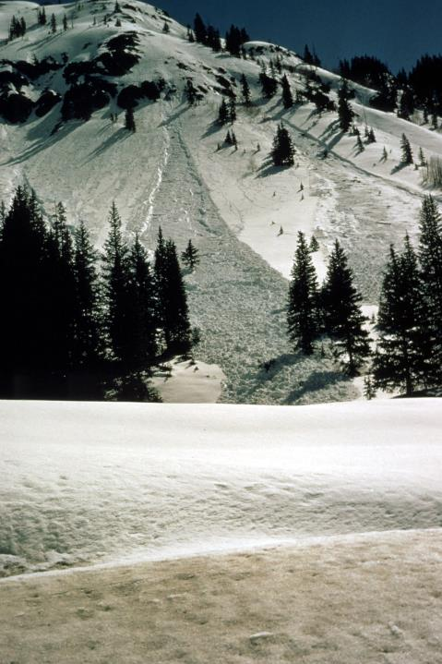
Signs of
Rapid Warming

Slide 37
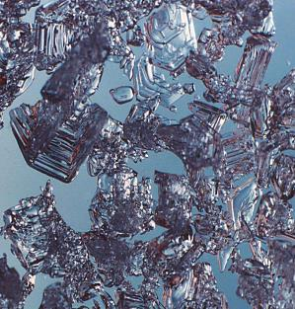
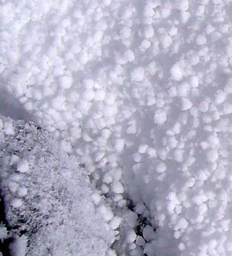
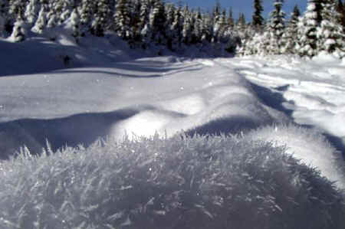
Surface Hoar
Snowpack
The beauty and the beast
Facetted Snow
Graupel Snow

Slide 38
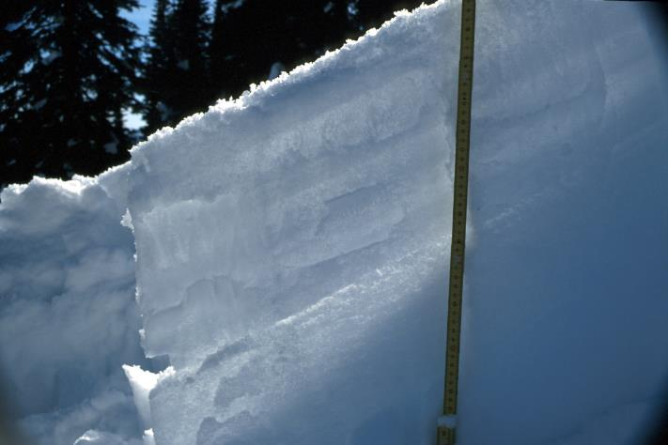
Weak Layer Identification
Notes:
38

Slide 39
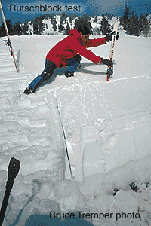
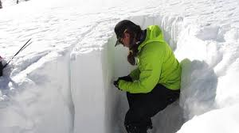
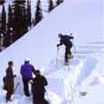
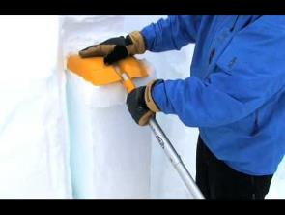
Stability Testing – skills taught in Level I courses

Slide 40
HUMAN FACTOR
In Avalanche Accidents
Are you able to make an objective assessment of the avalanche danger and act appropriately?
Notes:
This question is harder to answer than you may think. Its easy to get sidetracked and single minded when it comes to getting outside and playing. Maybe it just snowed a foot and you’ve got your brand new pair of skis that you’re just itching to test drive. Will you pay attention to all the signs, or just selectively choose those that will allow you to ride, ignoring those that may put a damper on the fun?
Ignorance is not bliss and as some of these stories have shown, death can come swiftly to those who see only what they want to see.

Slide 41
Decision Making
How do humans make decisions?
What we see
Past experience
Anticipation
Desire
Notes:
How do we make decisions? This can be a complex interplay of factors involving: what we observe, our past interactions with snow and perhaps near missing or false positives (times when you were uncertain about snow stability, but rode and got away with it despite our possible ignorance), what we think will probably happen and worst of all our Desire.

Slide 42
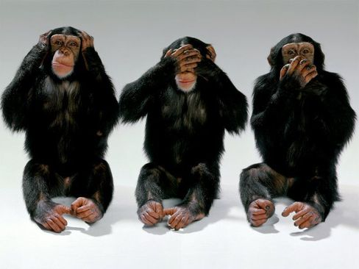
Denial is not just a river in Egypt

Slide 43
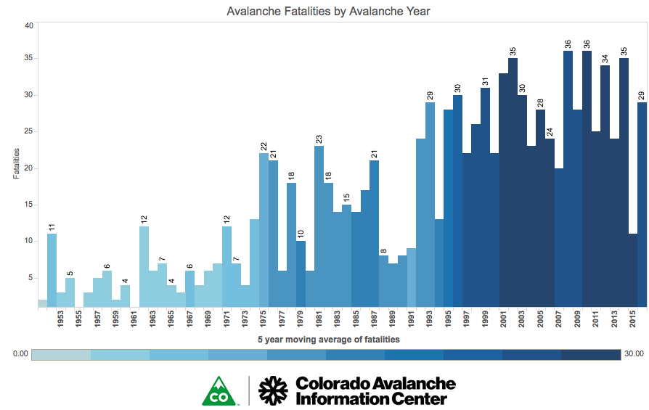
Notes:
Here is a graph depicting the trends in yearly avalanche fatalities ending a decade ago

Slide 44
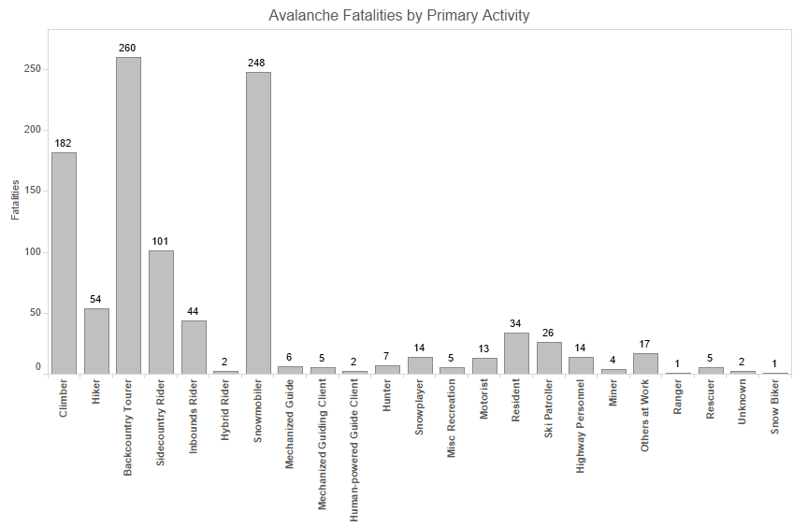

Slide 45
Accidents by level of avalanche training

Slide 46
Gaining practical experience is the best teacher but unfortunately …
“When it comes to avalanche education, the final exam may precede the lesson.” Dale Atkins – CAIC
“Avalanches don’t know that you are an avalanche expert.” Bruce Tremper - Utah Forecaster
“It is not what we don’t know that kills us, it is what we know that isn’t actually so.” Will Rogers

Slide 47
Decision making when high levels of uncertainty exist
Heuristics (behavioral patterns based on familiar situational clues)
Generally these work: example - look both ways before crossing the street
Heuristic traps

Slide 48
Heuristic Traps - FACETS
Familiarity Trap
Acceptance
Commitment Trap
Expert Halo Trap
Tracks (Social Consensus/Facilitation Trap)
Scarcity Trap

Slide 49
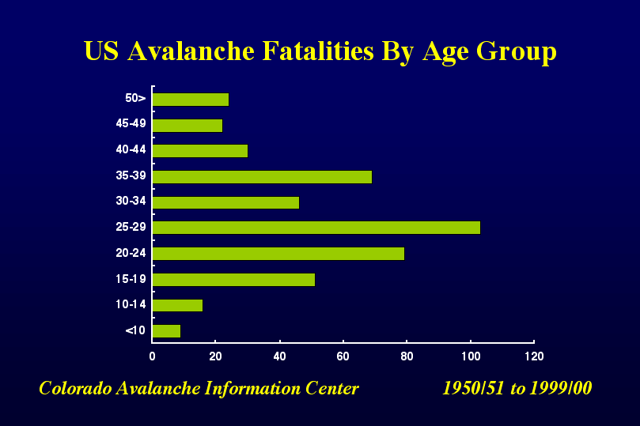

Slide 50
Safety by group size
Solo is probably safest from a judgment point of view
Pairs are good but resources are limited
Threes or fours are probably the safest group size
Five to seven is cumbersome and difficult to manage
More than seven puts excessive load on snowpack
Notes:
Solo is probably safest from a judgment point of view – but you are cooked if you are wrong
Pairs are good but resources are still limited
Three is probably the safest group size
Four is OK but communications are stretched
Five to seven is cumbersome and difficult to manage
More than seven put excessive load on snowpack

Slide 51
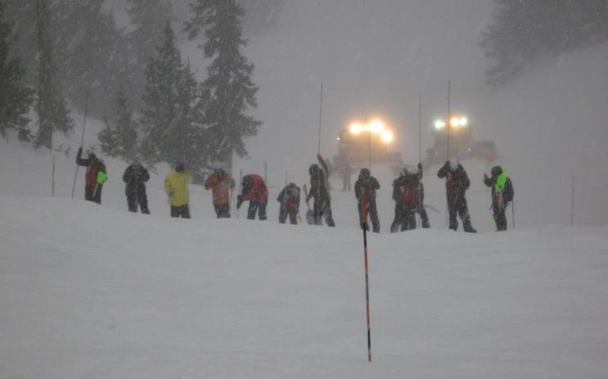
Listen to the snow with all your senses

Slide 52
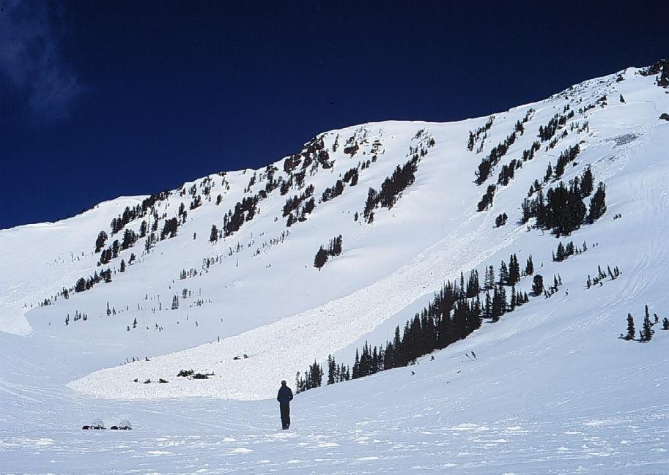
Recent avalanche activity is a big Red Flag
52
Notes:
52
Recent avalanches are a huge sign of instability. Can the snow slide? Yes, in fact it already did!!
<click>
Do you think it would be a good idea to snowmobile on the untracked snow in between these two avalanches?
<click>
NO!
Pay attention to the Mother Nature since she’s always giving signs about the snow stability if you know how to read them. Recent avalanche activity is one of natures most obvious warning that the snow is unstable and can slide!! This simple observation is missed more than you can imagine. Have your eyeballs open out there!
Many times as you’re driving to the trailhead you’ll have opportunities to look at the surrounding terrain and search for recent avalanches. Start formulating your own assessment of the snow stability before you get on your machine.

Slide 53
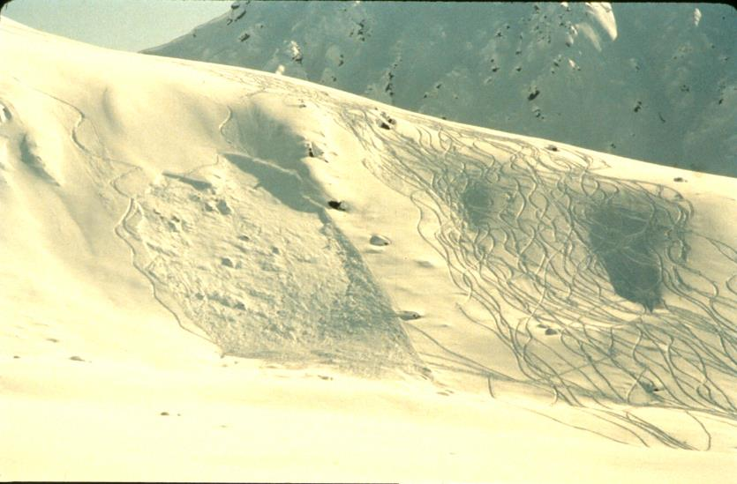
RECENT AVALANCHES ?
So much for Red Flags changing behavior
Notes:
Ski track were thought to mean that the slope had been test driven and was therefore safe. In this slide we see an adjacent slope with almost identical configuration (aspect relative to sun and snow accumulation, slope angle, and even rollovers) yet it slid. The thought is that skier seem to have continued to ski the slope in the right-hand view.

Slide 54
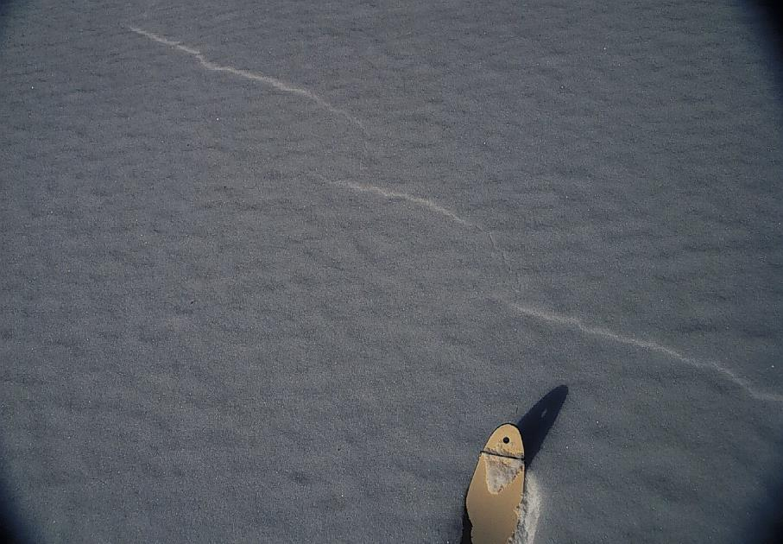
Pay Attention To OBVIOUS Signs of Unstable snowpack
These include collapsing with a “whumphing” sound and/or cracking of the snow
Notes:
54
<click>
Shooting cracks in the snow, or “whumping” as you travel are HUGE signs that unstable snow exists. A “whump” means that you just collapsed a weak layer.
This photo was taken in a flat field. Had the skier been on a steep slope he most likely would’ve triggered a slide.
Snowmobilers should get off their sleds and walk around occasionally.

Slide 55

RAPID SNOW LOADING
Most avalanches occur within 24 hours after a storm
Wind Slabs are most reactive during a wind event and the first day or two after it has ended

Slide 56

Thaw
Instability
Wet Slab Avalanches often follow several nights of above freezing temps

Slide 57

Learn to identify avalanche terrain and particularly major paths
Art Pundt collection
Notes:
57

Slide 58

When in doubt, avoid big avalanche path
Art Pundt
Notes:
58

Slide 59

Avalanche Danger Scale
From avalanche center forecasts or from posted backcountry observations— www.kachinapeaks.org
Notes:
59

Slide 60
What if you made the wrong assessment….perhaps based on bad information or poor judgment ?
What is your insurance policy?

Slide 61

CARRY and KNOW HOW TO USE
RESCUE GEAR!!
OR EVEN MORE IMPORTANT…make sure your PARTNER has rescue gear!
Notes:
Carrying rescue gear is a no brainer. Yes it’s pricey, but not compared to dying. If you're completely buried people need to find you a beacon is the only way. Remember, you’ve got 15 minutes to be found, and then you’ve got to be dug out. Avalanche debris sets up like concrete. There are countless stories of people trying to dig out their partner with their windshield, hands, or whatever they can find. This is unacceptable. Carry a real shovel, and better yet, carry it on you. A probe is an awesome tool to help pinpoint the buried person to minimize your time digging. It also is an essential tool if you’re looking for someone who failed to wear a beacon because it allows you to spot probe around.
Once again, this is a way to stack the deck in our favor in the event we’ve made a mistake in assessing avalanche danger.

Slide 62
Safe Travel Avoids Rescue
Travel Principles
One at a time
Safe zone to safe zone
Communicate and keep an eye on each other
Using terrain to your advantage
Rescue
You are your party’s primary rescue resource
Go fast by going slow (stay calm and focused)
Victim response – fight to stay on top, and clear an air space

Slide 63
“Climb and ski if you will but remember that courage and strength are naught without prudence, and that a momentary negligence may destroy the happiness of a lifetime. Do nothing in haste, look well to each step; and from the beginning think what might be the end”
Whymper (1871)

Slide 64

Visit and support KPAC www.kachinapeaks.org
Advanced avalanche courses available
Sign up for weekly snowpack summaries sent directly to you phone or email
Participation with fundraisers and events

Slide 65

Choose Wisely
Have Fun!
Be prepared

